Slide 2
IWPA 2021 - 2022 Championships

Slide 3
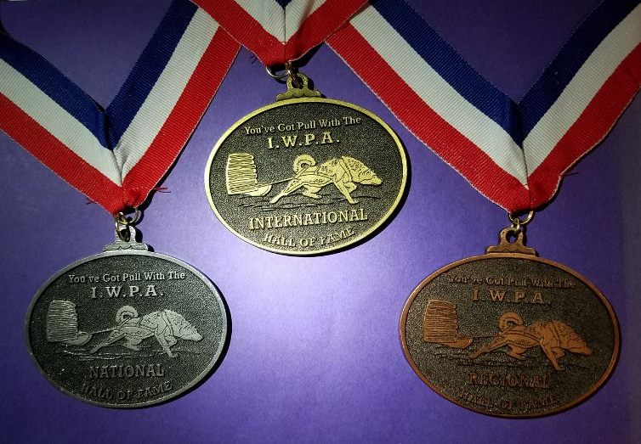

Slide 4
IWPA Regional Hall of Fame

Slide 5
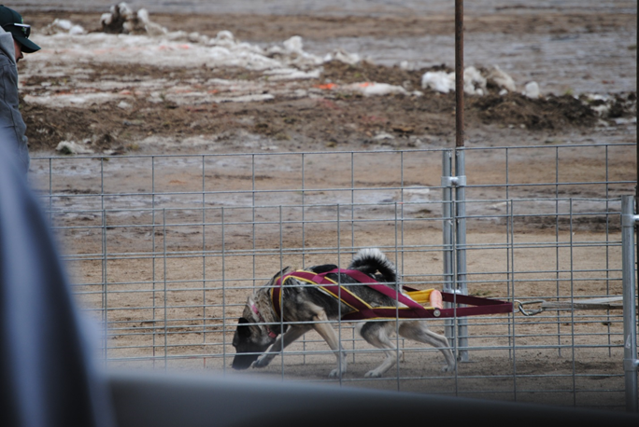
REGION 9 Daffodil Inducted into IHOF on June 1, 2019
Owner/Handler
Rodney and Cheryl Martin

Slide 6
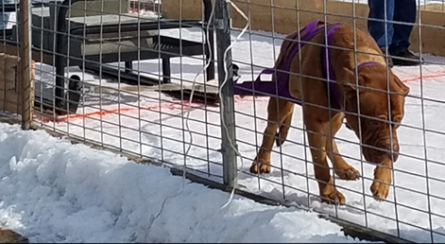
REGION 9 Royal’s Conqueror “Prince Mufasa” Inducted into IHOF on June 1, 2019
Owned/Handled by Robbie and Terry Reed

Slide 7
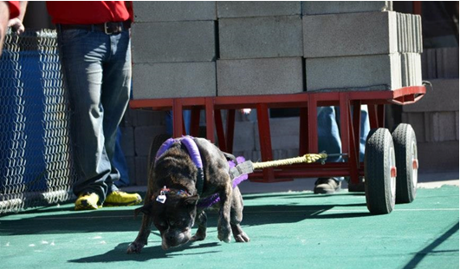
REGION 3 Jynx Inducted into IHOF on June13, 2020.
Owner/Handler
Sean Hammell

Slide 8
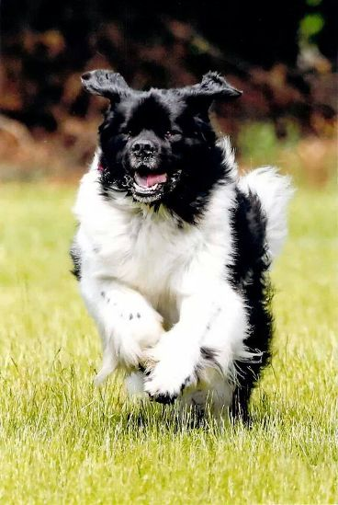
REGION 6 Micky Inducted into IHOF on June13, 2020
Owner/Handler
Jean Wilson

Slide 9
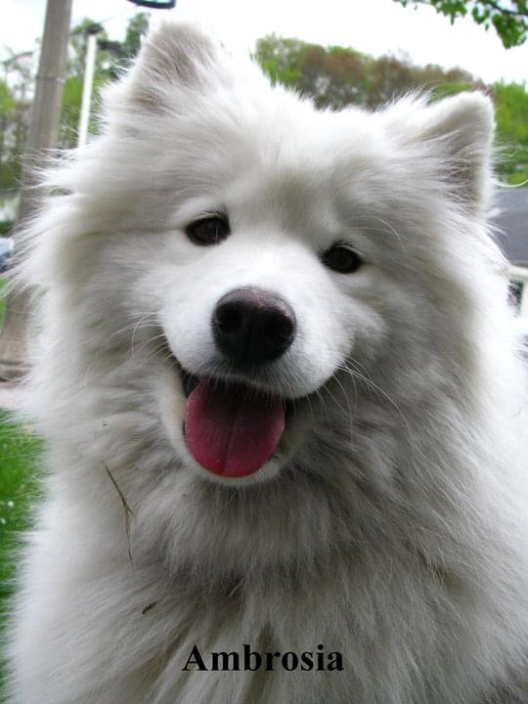
REGION 11 Brosia Regional HOF June 12, 2021
Owner/Handler
Mary Wolf

Slide 10
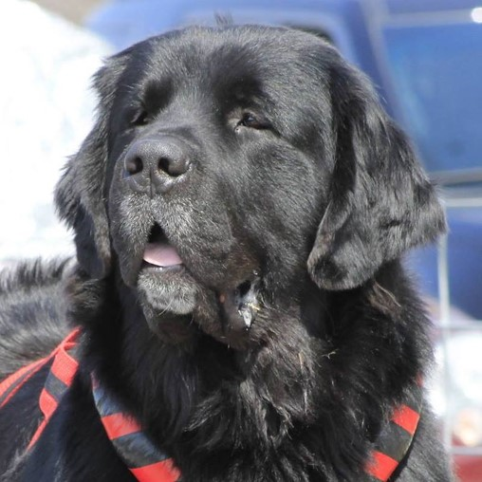
REGION 6 Brody Inducted into IHOF on June 12, 2021
Owner/Handler
Jean & Barry Wilson

Slide 11
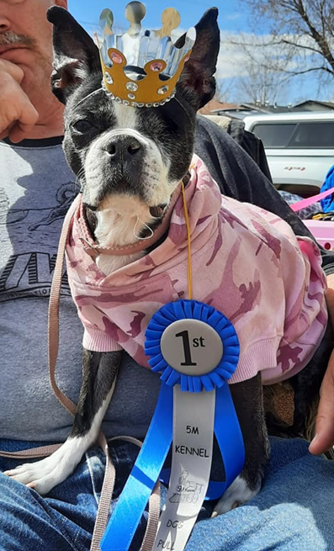
REGION 9 Princess Bekah Inducted into IHOF on June 12, 2021
Owner/Handler
Terry & Robbie Reed

Slide 12
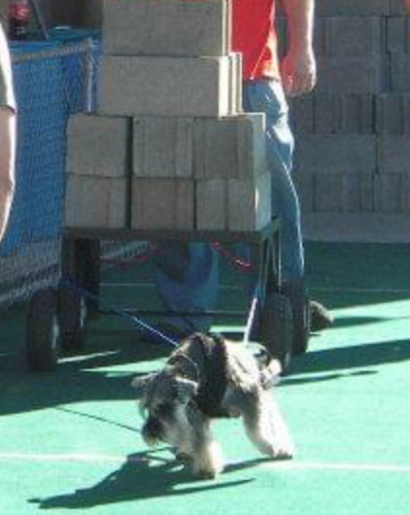
REGION 9 Caesar Applicant for IHOF and will be voted on during the board meeting June 2022
Owner/Handler
Richard Felice

Slide 13
The IWPA International and National Hall of Fame inductee applicants will be discussed during the upcoming Board Meeting in June and their Inductions will be announced in the August 2022 Pulling Power Newsletter.
Congratulations to all Regional and International Hall of Fame recipients!

Slide 14
To date, since the beginning of the HOF program in the 2012-2013 season there are a total of 40 Regional HOF recipients, 5 National HOF Inductees as well as 17 International HOF Inductees with 1 pending applicant. For a total of 62 combined awarded HOF recipients and 1 pending HOF induction.

